Slide 1
REQ-890 – CNFO – Jakarta Extensions
Lukasz Rajewski (Orange)
Seshu Kumar M (Huawei)
Marcin Krasowski (Samsung)

Slide 2
CNFO - Summary for the requirement subcommittee
REQ-341
Executive Summary - Provide CNF orchestration support through integration of K8s adapter in ONAP SO
Support for provisioning CNFs using an external K8s Manager
Support the Helm based orchestration
leverage the existing functionality of Multi cloud in SO
Bring in the advantages of the K8s orchestrator
Set stage for the Cloud Native scenarios
Owners: Lukasz Rajewski (Orange), Seshu Kumar M (Huawei)
Business Impact - Enables operators and service providers to orchestrate CNFs based services along with the VNFs and PNFs
Business Markets - All operators and service providers that are intended to use the CNFs along with PNFs / VNFs Funding/Financial Impacts - Reduction in the footprint of the ONAP for CNF support. Organization Mgmt, Sales Strategies -There is no additional organizational management or sales strategies for this requirement outside of a service providers "normal" ONAP deployment and its attendant organizational resources from a service provider.
Guilin
REQ-458
Honolulu
REQ-627
Istanbul
REQ-890
Jakarta

Slide 3









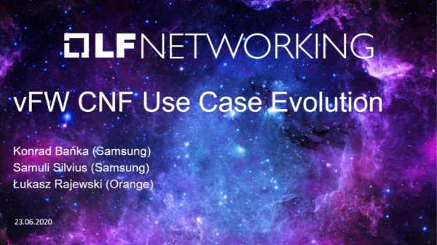
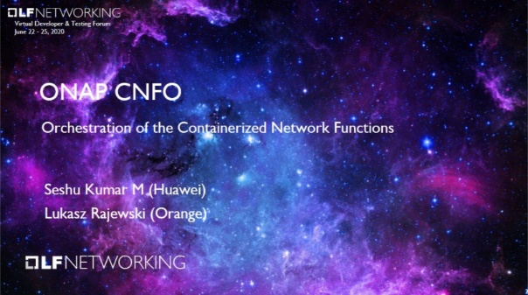



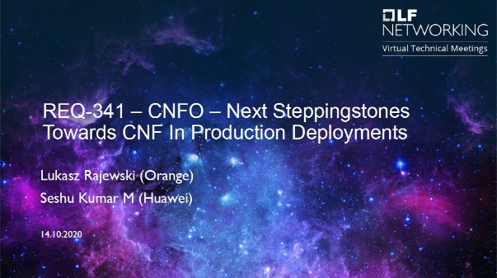

CNFO Evolution
REQ-182
REQ-341
REQ-890
REQ-458
REQ-627

Slide 4
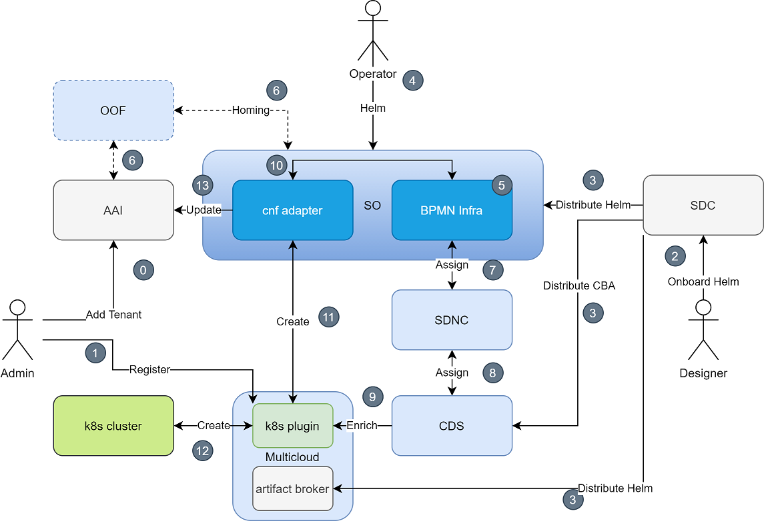
CNFO After Istanbul
Helm Onboarding [SDC]
Day 0/1 Customization [CDS/MC]
Instantiation [SO/MC]
Day 2 Configuration [CDS/MC]
State Synchronization [SO/AAI/MC]
Healthcheck [SO/CDS/MC]
Multi-cluster deployment [SO/MC]
VNF/PNF Integration [ALL]
E2E Service Automation [SDK]

Slide 5
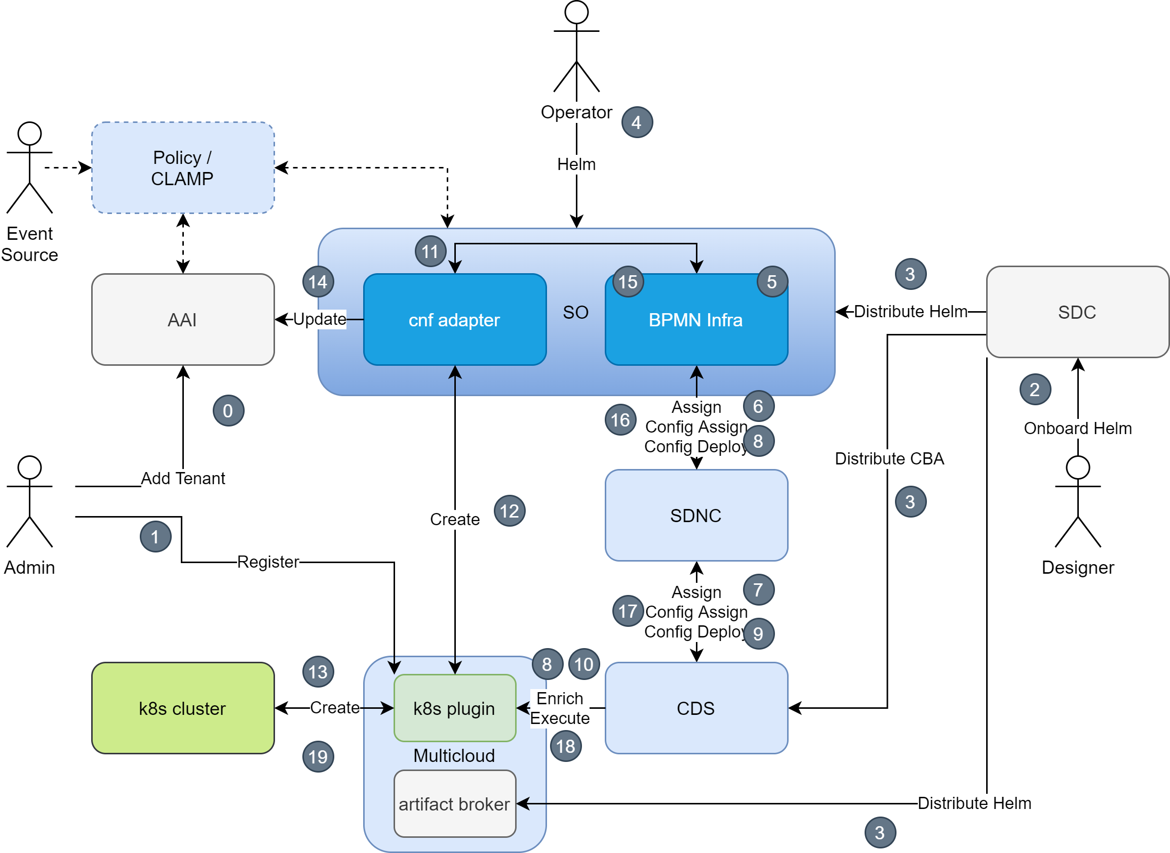
Istanbul - CNF Adapter Instantiation Flow
Improved Day2 & CNF Upgrade
AAI Update After CNF Creation
SO CNF (Helm) Upgrade Workflow
Improved CDS support for CNF Day2
CNF adapter
HELM

Slide 6
CNF Upgrade – Jakarta (1)
Upgrade CNF Instance – like Helm Upgrade operation
Currently we can only Upgrade CNF with Build & Replace scenario
Update Service model
Create New CNF Instance
Delete Old CNF Instance
It results with service disruption if traffic migration is not applied
Instead, we may want to upgrade CNF In-Place with native Kuberentes Upgrade strategy
Helm creator may assure non-disrupted CNF operation
Requires Service Model update
New Helm package uploaded to SDC from new VSP
Since Istanbul we can distribute updated model to k8splugin

Slide 7
CNF Upgrade – Jakarta (2)
SO
AAI
SDNC
CDS
SO: CNF Adapter
K8s Plugin
K8s cluster
Upgrade CNF
Deactivate vf-module
Deactivate vnf
Change VNF Model
vnf Config-Upgrade-Assign
Config Template
Change vf-module Model
Upgrade vf-module in K8s
Upgrade RB Instance
Update K8s Resources
K8s Resources Status
k8s-resource
vnf Config-Upgrade-Deploy
Config Instance
Activate vf-module
Activate vnf

Slide 8
AAI model: k8s resource object - Istanbul
Attribute | Type | Mandatory
Id | UUID | Yes (PK)
Name | String | Yes
Group | String | Yes
Version | String | Yes
Kind | String | Yes
Labels | List of strings | Yes
Namespace | String | Yes
K8s-resource-selflink | URI | Yes
K8s resource is basic AAI entity
to model resources created in
K8s cluster.
It plays similar role as vserver
resource for standard VNFs.
Relations
Tenant
Generic-Vnf
Vf-Module

Slide 9
Instantiation of the Helm Chart – Istanbul
SO
AAI
SDNC
CDS
SO: CNF Adapter
K8s Plugin
K8s cluster
Create Service
Assign Service, Assign VNF
Create vf-module
Assign vf-module
Assign vf-module
Assign result
Build RB Profile
vf-module assigned
Assign vf-module
RB Profile
[Helm enrichment]
vf-module assigned
Update vf-module
vnf Config-Assign
Config Template
Create vf-module in K8s
Create RB Instance
Install K8s Resources
K8s Resources Status
Big Bang!
k8s-resource
vnf Config-Deploy
Config Instance

Slide 10
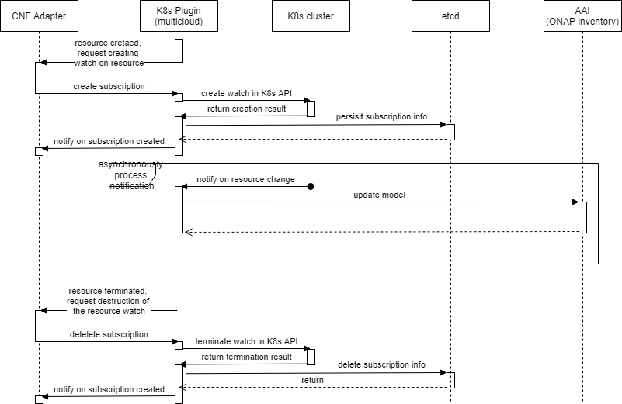
CNF AAI Update - Jakarta
SO: CNF Adapter
K8s Plugin
K8s cluster
K8s Plugin (etcd)
AAI
CNF Adapter creates status notification subscription
K8s Notifies on Resource’s change
K8sPlugin Sends Subscription Notification
CNF Adapter Determines type of change
Create new k8s-resource
Deletes k8s-resource
Update K8s resource version

Slide 11


Scope for REQ-890 – Jakarta
Multicloud/K8sPlugin
Instance Helm Upgrade
Base on new RB definition version
Similar to Helm Upgrade operation
Pre-/Post Upgrade Hooks
Status API notifications mechanism
Further improvements for Day2 Config API
CCSDK/CDS
Native Support for k8sPlugin APIs added in Istanbul & Jakarta
Root Level Query API
Updates in the Profile API
Updates in the Config API
REQ-890

Slide 12
Scope for REQ-890 – Jakarta
SO CNFO Enhancements
AAI synchronization after Day-2 Operations
Auto-update of information in AAI (K8sResource Create/Update/Delete)
Based on status notifications from k8sPlugin
No need to manually update AAI if something changes in K8s
CNF Upgrade Support
CNF Upgrade BB (Helm Upgrade)
CNF Upgrade Workflow
New cnfUpgrade endpoint for serviceInstantiation API
New upgrade endpoint of cnf-adapter
REQ-890

Slide 13
API Changes Summary (1)
SO API Handler
POST onap/so/infra/serviceInstantiation/{serviceInstanceId}/vnfs/{vnfInstanceId}/upgradeCnf
Consumer: end user
Purpose: Trigger the upgrade of the specified CNF Instance
SO CNF Adapter
POST api/cnf-adapter/v1/instance/{instanceID}/upgrade
Consumer: SO BPMN Infra
Purpose: Perform the upgrade of the CNF instance
Multicloud – K8sPlugin
POST v1/instance/{instance-id}/upgrade
Consumer: SO CNF Adapter
Purpose: Upgrade existing CNF instance
POST v1/{instance-id}/status/subscription
Consumer: SO CNF Adapter
Purpose: Create status notification subscription

Slide 14
API Changes Summary (2)
Multicloud – K8sPlugin
GET v1/{instance-id}/status/subscription
Consumer: SO CNF Adapter
Purpose: Get list of subscriptions for created instance
GET v1/{instance-id}/status/subscription/{subscription-id}
Consumer: SO CNF Adapter
Purpose: Get details of specific status notification subscription
PUT v1/{instance-id}/status/subscription/{subscription-id}
Consumer: SO CNF Adapter
Purpose: Update specific status notification subscription
DELETE v1/{instance-id}/status/subscription/{subscription-id}
Consumer: SO CNF Adapter
Purpose: Delete status notification subscription

Slide 16
SO

Slide 17
CNF UPGRADE WORKFLOW

Slide 18
CNF/Helm Upgrade: Design in SDC
No changes required in SDC
Since Istanbul we can Upgrade Helm package in VF Model
It is distributed to SO and K8sPlugin
How to Upgrade Service Model with CNF in SDC?
Create new VSP with updated helm chart(s)
Update existing VF with newly created VSP
Update Service and distribute new service model version.

Slide 19
CNF/Helm upgrade:
CNF upgrade is 2 steps process.
Step 1: Upgrade existing service instance to newer model in SDNC and AAI.
This functionality is available in I release
Step 2: Upgrade CNF - helm upgrade
(new functionality)
Why is this process decoupled into two steps?
Decomposition makes sense when we have more than on CNF in Service
We may perform additional actions in between upgrade of CNF instance
We may upgrade only selected CNF instance
We may upgrade with selected method
Build and Replace (since Istanbul)
In Place Upgrade (since Jakarta)

Slide 20

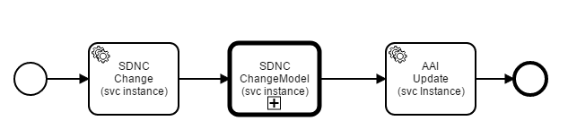
Step 1 - Update service model
Existing functionality available from I release
Trigger endpoint Url: /onap/so/infra/serviceInstantiation/v7/serviceInstances/$SERVICE_INSTANCE_ID/upgrade
It will trigger below building block
Service model SDNC and AAI will get update

Slide 21
Step 2 - CNF upgrade flow
New end point:
End point url: /serviceInstances/{serviceInstanceId}/vnfs/{vnfInstanceId}/upgradeCnf
Method: POST
Request payload: same as ‘serviceInstances’ api
Below Building Blocks will get execute:
SEQ_NO | FLOW_NAME | SCOPE | ACTION
1 | AAICheckVnfInMaintBB
2 | AAISetVnfInMaintBB
3 | DeactivateVfModuleBB
4 | DeactivateVnfBB
5 | ChangeModelVfModuleBB
6 | ControllerExecutionBB | vnf | config-upgrade-assign
7 | UpgradeVfmoduleBB >>>> New BB
8 | ControllerExecutionBB | vnf | config-upgrade-deploy
9 | ActivateVfModuleBB
10 | ChangeModelVnfBB
11 | ActivateVnfBB
12 | AAIUnsetVnfInMaintBB

Slide 22
CatalogDb changes for CNF upgrade flow
service_recipe table
Add new recipe ACTION as “upgradeCnf”
northbound_request_ref_lookup table
Add MACRO_ACTION as “CNF-Macro-Upgrade”
orchestration_flow_reference table
Add building blocks for COMPOSITE_ACTION as “CNF-Macro-Upgrade”
building_block_detail table
Add new building block UpgradeVfmoduleBB

Slide 23
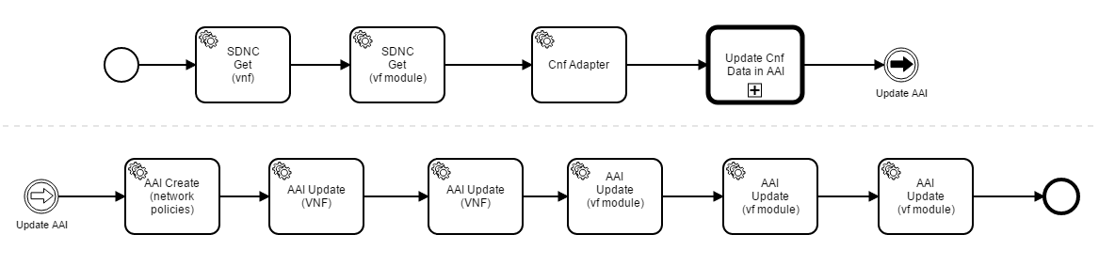
UpgradeVfmoduleBB workflow
Call new end point to upgrade CNF(s)
It is assumed that flow will be like CreateVfModuleBB

Slide 24
SO API changes: API Handler
New endpoint in SO API Handler
Url: onap/so/infra/serviceInstantiation/{serviceInstanceId}/vnfs/{vnfInstanceId}/upgradeCnf
Method: POST
Request payload: JSON object “gBuildingBlockExecution” (which is same as CreateVfModuleBB)
DETAILS
Cloud Region?
Inputs?
Should we let to specify full request or some parameters are taken from?
New endpoint in CNF Adapter

Slide 25
SO API changes: CNF Adapter
New endpoint in CNF Adapter
POST: api/cnf-adapter/v1/instance/{instanceID}/upgrade
Response: Like Create Instance
BODY:
{
"modelInvariantId": "some uuid of new vf model",
"modelCustomizationId": "some another uuid of new vf model",
"k8sRBProfileName": "new-profile-name",
"k8sRBInstanceStatusCheck": false,
"cloudRegionId": "we may change region",
"vfModuleUUID": "just if for the future",
"labels": "we just pass labels from the BPMN Infra",
"override-values": "and we pass overrides from the BPMN infra"
}

Slide 26
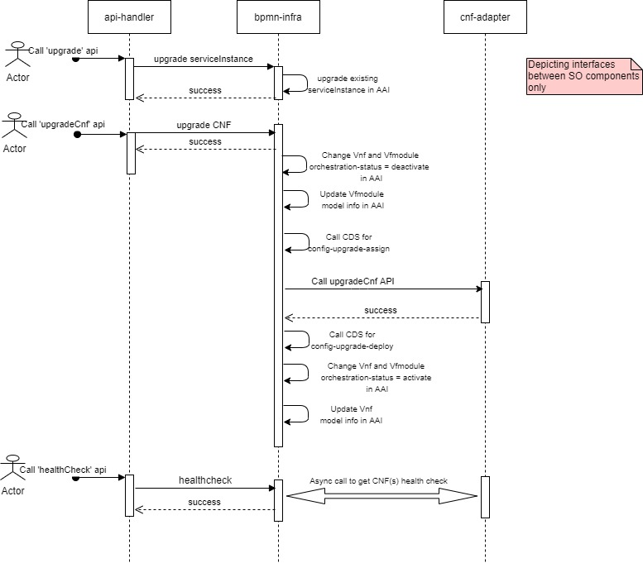
CNF upgrade e2e flow

Slide 27
MUTLICLOUD

Slide 28
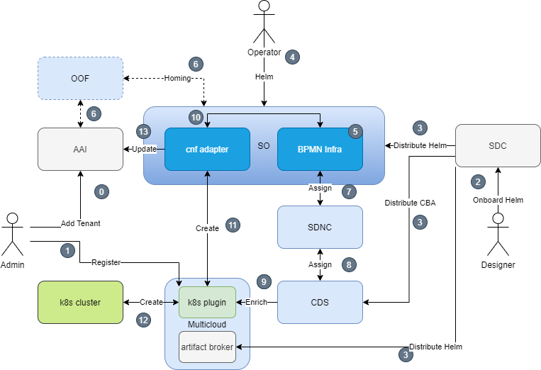
Istanbul – CNF/Helm Day0/1 Flow
HELM

Slide 29
K8splugin changes - Summary
Major Changes
Upgrade Instance
Pre-/Post- UpgradeHooks
Pub/Sub API for Status Change Notifications
Config Templete from definition
Created/Updated APIs target:
Implementation of subscription-based API for Status change notifications
RB Instance Upgrade endpoint
Detailed development is tracked in MULTICLOUD-1386 story

Slide 30
Helm Upgrade Support
Instance Upgrade Endpoint
Request the same like create with InstanceId as a additional parameter
New resources created, existing upgraded, old removed
Mimic of the implementation of helm hooks for upgrade operation
Support of pre/post upgrade hooks.
Hooks can be created in order, one by one (or at same time if they have same weight), next one must wait for previous one to finish before continue.
Support hook upgrade policy

Slide 31
v1 Instance API Change – UPGRADE instance req
POST http://multicloud-k8s:9015/v1/instance/<id>/upgrade
BODY: {
"rb-name": "${rb_name}",
"rb-version": "${rb_version}",
"profile-name": "${profile_name}",
"cloud-region": "${cloud_region_id}",
"labels": {
"custom-label-1": "abcdef"
},
"override-values": {
"image.tag": "latest",
"dcae_collector_ip": "1.2.3.4"
}
}
VF Module model invariant ID
VF Module model customization ID
k8s-rb-profile-name (SDNC Directives)
SO decides
SO decides, anything what later on might be used by k8s adapter in SO
SDNC Directives

Slide 32
API Changes – subscription based Status API (1/3)
API to be used i.e. for synchronization with AAI after Day2 changes
The creator of the subscription should be notified about k8s resources changes (create/delete/modify)
Notification will allow to identify modified resource, new resourceVersion and the type of change
Full details about current state of the resource should be resolved by Status/Query API

Slide 33
API Changes – subscription based Status API (2/3)
Subscription-based Status API allows for subscribing for given RB instance to receive incremental updates about its status change
Subscription Status API would provide following interfaces (part 1)
POST /v1/{instance-id}/status/subscription
Register for instance status
Request (encoded in json object):
name – [Mandatory] string - name of the subscription
callback-url – [Mandatory] string – URL to use for sending updates, example “http://dummy.svc:8080/vnf/x/vf-module/y/status/listener”
min-notify-interval – [Mandatory] int - min time between notifications (0 – no limit)
metadata – [Optional] json – payload to send back
Response (encoded in json object) – look at GET result
GET /v1/{instance-id}/status/subscription
Response – list of existing subscriptions

Slide 34
API Changes – subscription based Status API (3/3)
Subscription Status API would provide following interfaces (part 2)
GET /v1/{instance-id}/status/subscription/{subscription-id}
Responds with details of existing subscription
Response (encoded in json object)
name – string - name of the subscription
last-update-time – datetime – Datetime of last subscription’s update message
last-notify-time – datetime – last time of notification attempt
callback-url – string – url of the notification endpoint
last-notify-status – int – last http status of notification request
min-notify-interval – int – min seconds between notifcations
metadata – json – payload to send back
DELETE /v1/{instance-id}/status/subscription/{subscription-id}
Deletes subscription

